Slide 1
Generative AI
Crafting Effective Financial Prompts for AI Tools

Slide 2
Understanding AI-Language Models in Finance
AI language models, particularly those based on transformer architectures like GPT, process financial prompts through a series of sophisticated steps:
Tokenization: Breaking down the input prompt into smaller units called tokens.
Embedding: Converting each token into a high-dimensional vector representation.
Contextual Processing: Analyzing relationships between different parts of the prompt.
Pattern Recognition: Identifying patterns relevant to the prompt based on training data.
Generation: Producing a response by predicting the most likely next tokens in sequence.
Financial Domain Adaptation: Incorporating domain-specific knowledge for finance-tuned models.
Context and specificity play crucial roles in generating accurate and relevant responses from AI models in financial applications. Providing clear context helps disambiguate terms and provide more accurate responses. Specifying relevant time frames, industry-specific context, and regulatory frameworks ensures the AI considers appropriate contexts. Clearly defining data requirements, using precise financial metrics, and specifying query scope leads to more accurate outputs.
Notes:
In the rapidly evolving landscape of financial technology, the ability to effectively communicate with AI systems has become a critical skill for finance professionals. As generative AI continues to transform various aspects of the financial industry, from risk assessment to personalized banking services, the importance of crafting effective prompts cannot be overstated.
Effective prompts serve as the bridge between human expertise and AI capabilities, enabling finance professionals to harness the full potential of generative AI tools. Well-crafted prompts lead to more accurate and relevant outputs, crucial for financial decision-making and analysis. They improve efficiency by streamlining processes and reducing time spent on data analysis and report generation. In the highly regulated financial sector, precise prompts ensure AI-generated outputs adhere to specific regulatory requirements and standards.

Slide 3
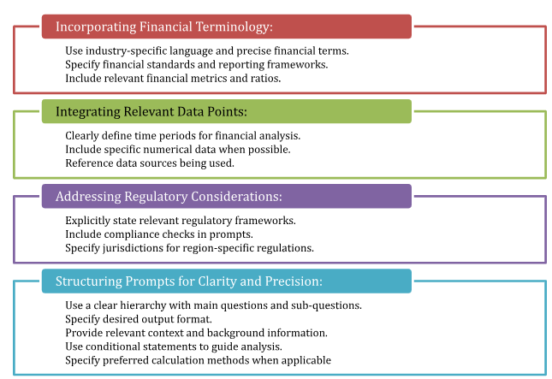
Best Practices for Financial Prompt Engineering

Slide 4
Crafting Prompts for Specific Financial Tasks
Financial Statement Analysis: Example prompts for basic financial ratio analysis, trend analysis, cash flow analysis, and segment performance analysis are provided. Key elements to include in prompts for financial statement analysis are:
Specific company and time period
Required financial statements
Specific metrics or ratios
Comparative analysis requests
Interpretation requests
Specific areas of focus
Desired output format

Slide 5
Crafting Prompts for Specific Financial Tasks
Risk Assessment: Example prompts for comprehensive risk profiles, credit risk assessment, market risk evaluation, liquidity risk analysis, and operational risk assessment are provided. Key elements to incorporate in risk assessment prompts include:
Specific risk types
Quantitative metrics
Time horizon
Comparative analysis
Scenario analysis
Data sources
Regulatory context
Risk mitigation requests
Visualization requests

Slide 6
Crafting Prompts for Specific Financial Tasks
Market Trend Analysis: Example prompts for comprehensive market analysis, sector-specific trend analysis, cryptocurrency market trends, global economic indicator analysis, and commodity market trend analysis are provided. Key elements to integrate into market trend analysis prompts include:
Specific market and time frame
Technical indicators
Volume analysis
Market sentiment indicators
Fundamental factors
Comparative analysis
Correlation analysis
Seasonality considerations
Regulatory environment
Forward-looking statements

Slide 7
Crafting Prompts for Specific Financial Tasks
Common Pitfalls and How to Avoid Them
1. Ambiguity in Financial Prompts:
Avoid vague terminology by being explicit about metrics.
Specify clear time frames for analysis.
Provide specific definitions for potentially ambiguous terms.
2. Overlooking Crucial Financial Context:
Specify industry and sector-specific benchmarks.
Include relevant market conditions and economic factors.
Mention significant company events that could affect analysis.
3. Neglecting Regulatory Compliance in Prompts:
Specify relevant accounting or reporting standards.
Consider jurisdictional differences in regulatory environments.
Include data privacy considerations in prompts.

Slide 8
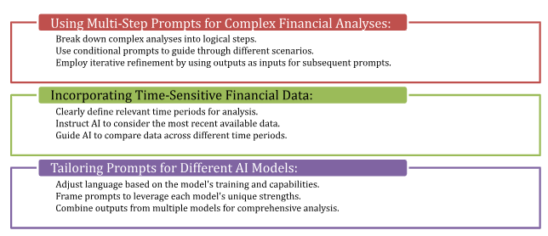
Advanced Techniques for Financial Prompt Engineering

Slide 9
Case Studies: Successful Financial Prompt Engineering
Investment Strategy Optimization - BlackRock's Aladdin Platform: BlackRock integrated generative AI into its Aladdin platform, crafting prompts that combined historical market data, current economic indicators, company-specific metrics, and macroeconomic trends. This approach resulted in a 15% improvement in portfolio performance and enhanced risk management.
Fraud Detection in Banking - HSBC's AI-Powered System: HSBC implemented a generative AI system for fraud detection, developing prompts that analyzed transaction patterns, customer behavior, geographical factors, and known fraud schemes. This led to a 50% reduction in false positive alerts and a 35% increase in fraud detection rate.
Automated Financial Reporting - PwC's AI-Driven Tool: PwC created an AI-powered tool for automated financial reporting, using prompts that extracted data from various systems, applied accounting standards, and incorporated narrative elements. This resulted in a 70% reduction in report preparation time and a 40% decrease in reporting errors.

Slide 10
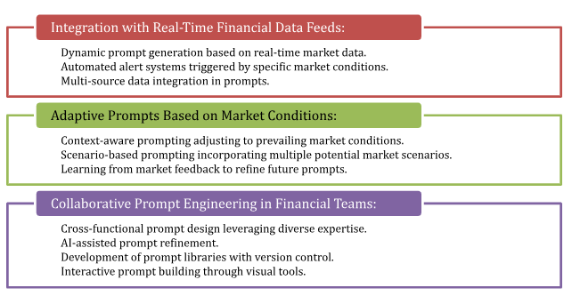
Future Trends in Financial Prompt Engineering

Slide 11
Conclusion
As generative AI continues to advance, the role of prompt engineering in finance is becoming increasingly critical. Key principles shaping the future of finance through generative AI include AI-driven financial analysis, personalization at scale, enhanced risk assessment and management, improved regulatory compliance, ethical considerations, and seamless integration with existing systems.
The evolving role of prompt engineering in finance emphasizes:
Precision in financial queries
Dynamic prompt generation
Regulatory alignment
Interdisciplinary collaboration
Continuous learning and adaptation
Ethical considerations in prompt design
Democratization of financial expertise
Notes:
As we look to the future, the intersection of generative AI and finance offers immense potential for innovation and improvement. The ability to effectively leverage AI through skilled prompt engineering will likely become a key differentiator for financial professionals and institutions. By mastering the principles and practices explored in this course, finance professionals are well-positioned to lead in this new era of AI-driven finance.

